Slide 1


Slide 2

globsyn

Slide 3


Slide 4

PREDICT LOAN APPLICATION STATUS
Group Members:
- SAYAN DEY, GOVT. COLLEGE OF ENGG & CERAMIC TECHNOLOGY,151130110024 OF 2015-16
-SURYA RUIDAS, GOVT. COLLEGE OF ENGG & CERAMIC TECHNOLOGY,151130110037 OF 2015-16
-KUNTAL DAS, GOVT. COLLEGE OF ENGG & CERAMIC TECHNOLOGY,151130110013 OF 2015-16
-SHREYA DAS, GOVT. COLLEGE OF ENGG & CERAMIC
TECHNOLOGY,151130110064 OF 2015-16

Slide 5
Table of Contents
Acknowledgement
Project Objective
Project Scope
Data Description
Model Building
Code
Future Scope of Improvements
Project Certificate

Slide 6

Acknowledgement
I take this opportunity to express my profound gratitude and deep regards to my faculty (Mr. Anubhav Chaturvedi) for his exemplary guidance, monitoring and constant encouragement throughout the course of this project. The blessing, help and guidance given by him/her time to time shall carry me a long way in the journey of life on which I am about to embark.
I am obliged to my project team members for the valuable information provided by them in their respective fields. I am grateful for their cooperation during the period of my assignment.
Sayan Dey Surya Ruidas Kuntal Das Shreya Das
www.globsynfinishingschool.c

Slide 7
Project Objective
PROBLEM STATEMENT: Multiclass classification problem for predicting loan application status from a rich dataset. The problem can be reduced to a binary classification problem to build a loan approval pre-check system for potential customers.
OBJECTIVE: The prime objective in banking environment is to invest their assets in safe hands where it is. Today many banks/financial companies approves loan after a regress process of verification and validation but still there is no surety whether the chosen applicant is the deserving right applicant out of all applicants. Through this system we can predict whether that particular applicant is safe or not and the whole process of validation of features is automated by machine learning technique. The disadvantage of this model is that it emphasize different weights to each factor but in real life sometime loan can be approved on the basis of single strong factor only, which is not possible through this system. Loan Prediction is very helpful for employee of banks as well as for the applicant also.
The aim of this Paper is to provide quick, immediate and easy way to choose the deserving applicants. It can provide special advantages to the bank. The Loan Prediction System can can automatically calculate the weight of each features
taking part in loan processing and on new test data same features are processed with respect to their associated weight .A time limit can be set for the applicant to check whether his/her loan can be sanctioned or not.

Slide 8
Project Scope
Loan Prediction is very helpful for employee of banks as well as for the applicant also.
The aim of this Paper is to provide quick, immediate and easy way to choose the deserving applicants.
It can provide special advantages to the bank. The Loan Prediction System can cautomatically calculate the weight of each features taking part in loan processing and on new test data same features are processed with respect to their associated weight .
Loan Prediction System allows jumping to specific application so that it can be check on priority basis. This Paper is exclusively for the managing authority of Bank/finance company.
8www.globsynfinishingschool.com

Slide 9

Data description
✓
Source of data: The data is available on Kaggle Datasets.In addition to the loan dataset, Kaggle provides a data dictionary explaining the column headers in much more detail allowing much better understanding of the problem at hand.
Each feature/column description
Dependent variable: ͚LoaŶ_Status͛ ;categorical)
Independent variables: ͚GeŶder͛;categoricalͿ, ͚Married͛;categoricalͿ, ͚ApplicaŶtIŶcoŵe͛;coŶtiŶuousͿ,
͚CoapplicaŶtIŶcoŵe͛;coŶtiŶuousͿ, ͚LoaŶAŵouŶt͛;coŶtiŶuousͿ, ͚LoaŶ_AŵouŶt_Terŵ͛;coŶtiŶuousͿ,
͚Credit_History͛;categoricalͿ, ͚Property_Area͛;categoricalͿ
➢
➢
➢
Null Percentage: 2.08

Slide 10

5 number statistics:
The five-number summary is a set of descriptive statistics that provide information about a dataset. It consists of the five most important sample percentiles:
the sample minimum (smallest observation)
the lower quartile or first quartile
the median (the middle value)
the upper quartile or third quartile
the sample maximum (largest observation)

Slide 11

Model Building
✓
Short description of each model used:
Linear Regression: In statistics, linear regression is a linear approach to modelling the relationship between a scalar response (or dependent variable) and one or more explanatory variables (or independent variables).
Logistic Regression:In statistics, the logistic model (or logit model) is a statistical model that is usually taken to apply to a binary dependent variable. In regression analysis, logistic regression or logit regression is estimating the parameters of a logistic model.
Decision Trees: The basic algorithm of decision tree requires all attributes or features should be discretized. Feature selection is based on greatest information gain of features. The knowledge depicted in decision tree can represented in the form of IF-THEN rules. This model is an extension of classification algorithms described by Quinlan.
Random Forest (RF): Random forests are a group learning system for characterization (and relapse) that work by building a large number of Decision trees at preparing time and yielding the class that is the mode of the classes yield by individual trees.
k-means clustering: is a method of vector quantization, originally from signal processing, that is popular for cluster
analysis in data mining. k-means clustering aims to partition n observations into k clusters in which each observation belongs to the cluster with the nearest mean, serving as a prototype of the cluster.

Slide 12
k- Nearest neighbors: In pattern recognition, the k-nearest neighbors algorithm (k-NN) is a non-parametric method used for classification and regression. In both cases, the input consists of the k closest training examples in the feature space.
Support Vector Machines: In machine learning, support vector machines (SVMs, also support vector networks) are supervised learning models with associated learning algorithms that analyze data used for classification and regression analysis.
Grid Search: The traditional way of performing hyperparameter optimization has been grid search, or a parameter sweep, which is simply an exhaustive searching through a manually specified subset of the hyperparameter space of a learning algorithm.
K Folds Cross Validator: Provides train/test indices to split data in train/test sets. Split dataset into k consecutive folds (without shuffling by default). Each fold is then used once as a validation while the k - 1 remaining folds form the training set.
Principal component analysis (PCA) is a statistical procedure that uses an orthogonal transformation to convert a set of observations of possibly correlated variables into a set of values of linearly uncorrelated variables called principal components.

Slide 13
•> For classification
Precision=TP/(TP +FP)
Recall=TP/(TP+FN)
Accuracy=(TP+TN)/(TP+TN+FP+FN)
f1-score=2*(Precision*Recall)/(Precision+Recall)
ROC curve: In statistics, a receiver operating characteristic curve, i.e. ROC curve, is a graphical plot that illustrates the diagnostic ability of a binary classifier system as its discrimination threshold is varied. The ROC curve is created by plotting the true positive rate (TPR) against the false positive rate (FPR) at various threshold settings.
AUC: When using normalized units, the area under the curve (often referred to as simply the AUC) is equal to the probability that a classifier will rank a randomly chosen positive instance higher than a randomly chosen negative one (assuming 'positive' ranks higher than 'negative')
•> For regression
●RMSE : The root-mean-square deviation (RMSD) or root-mean-square error (RMSE) (or sometimes root-mean-squared error) is a frequently used measure of the differences between values (sample and population values) predicted by a model or an estimator and the values actually observed.
●R-squared: It is a statistical measure that represents the proportion of the variance for a dependent variable that's explained by an independent variable.
•> Finally accepted model
DECISION TREE : ACCURACY=0.85

Slide 14
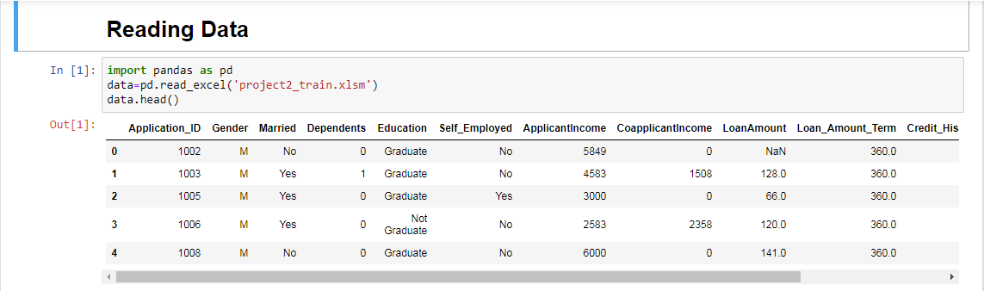
Code

Slide 15
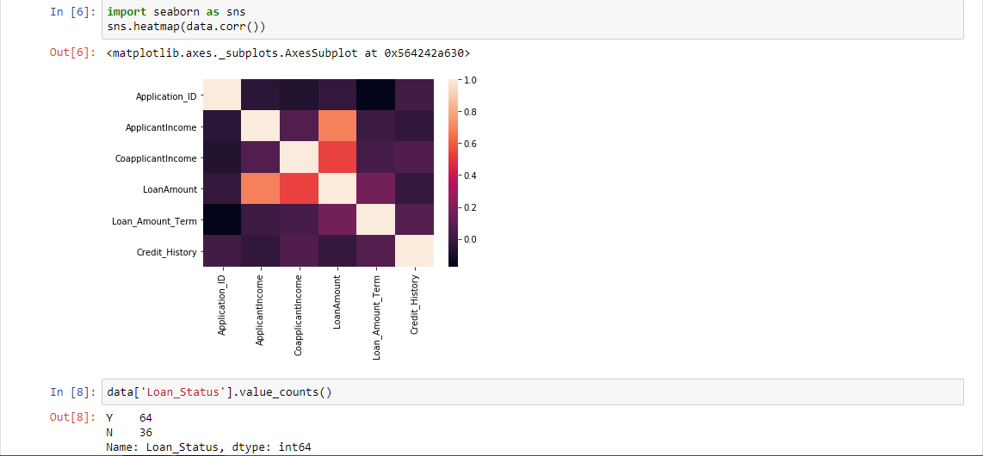
HEAT MAP

Slide 16
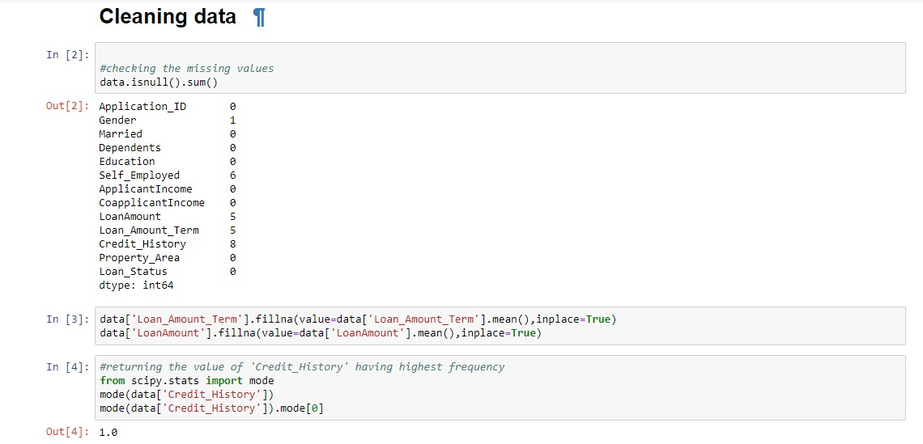

Slide 17
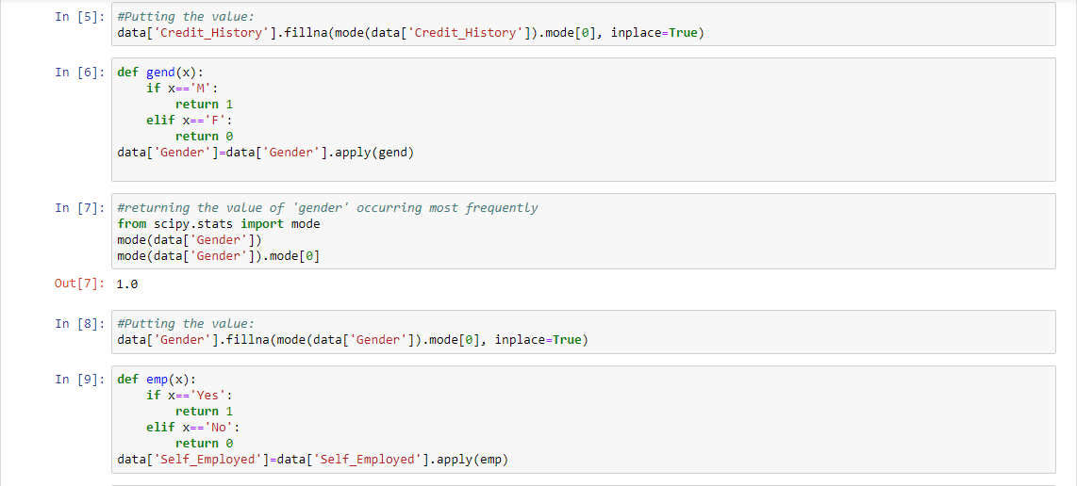

Slide 18
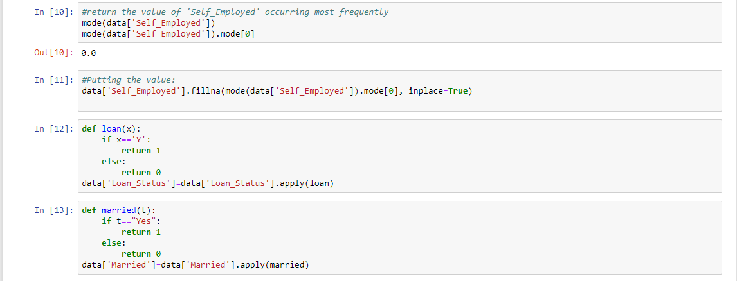

Slide 19
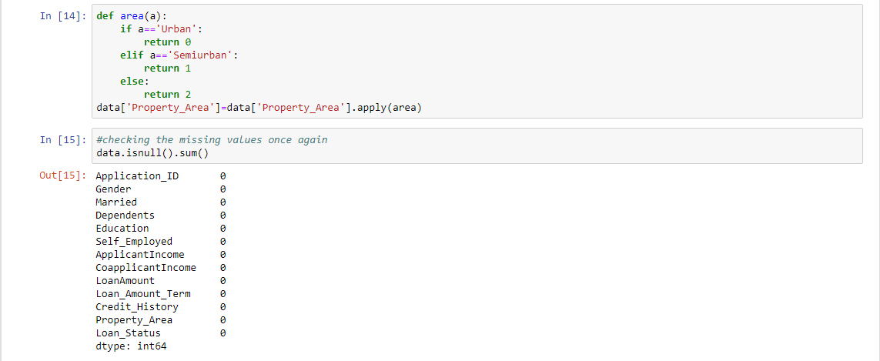

Slide 20
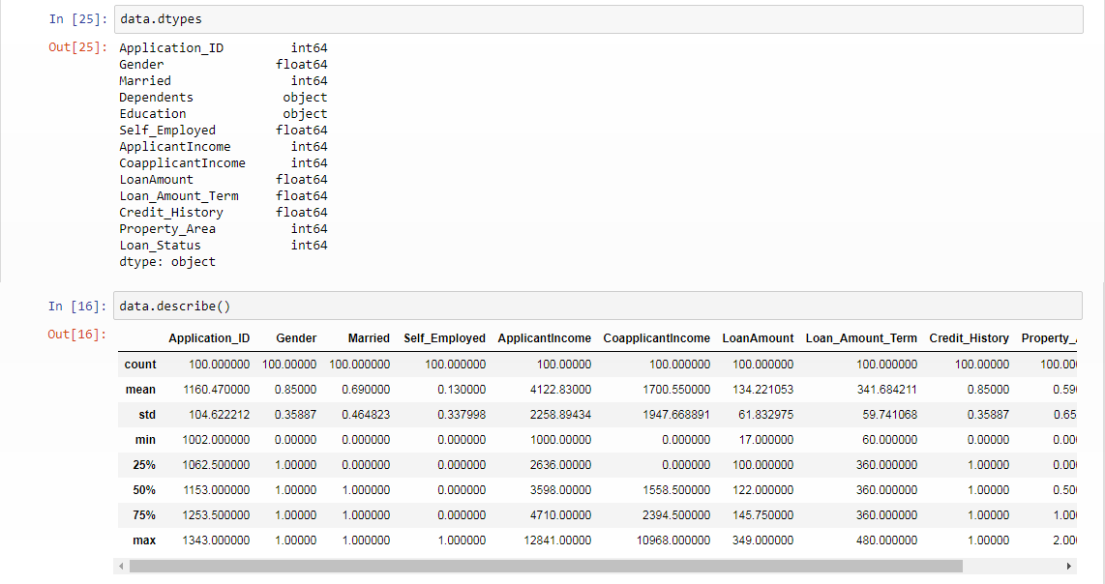

Slide 21
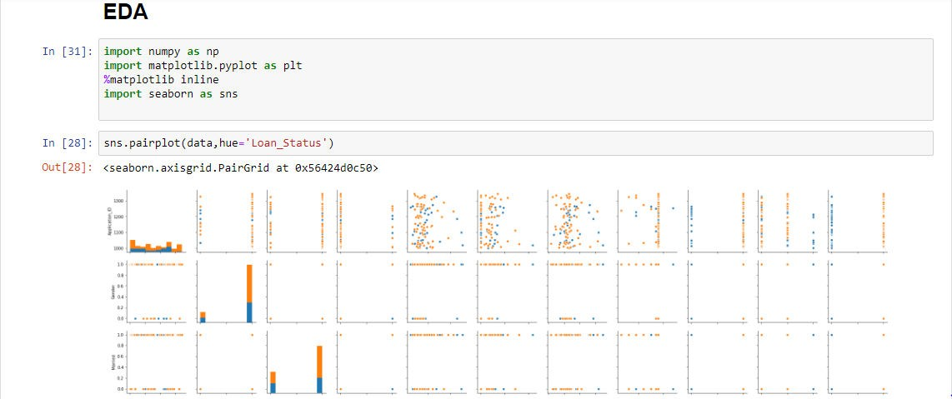

Slide 22
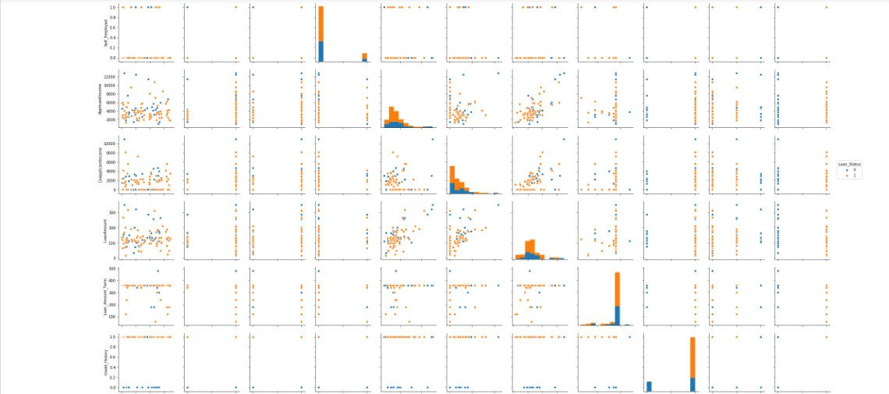

Slide 23
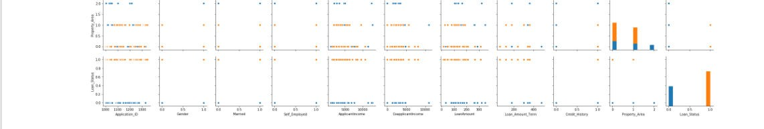
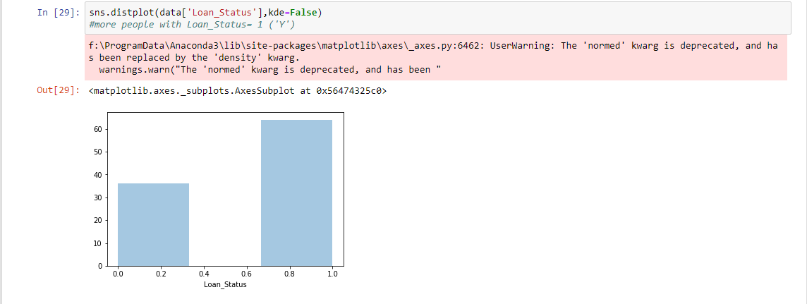

Slide 24
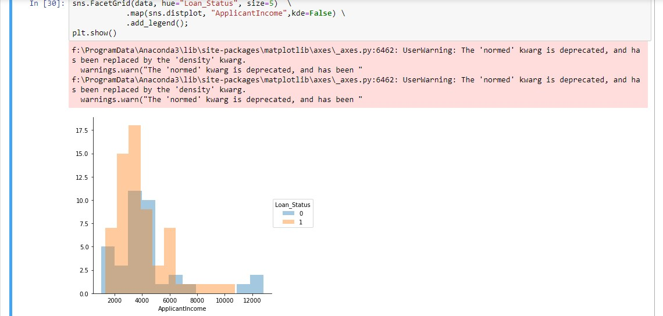
FACETGRID of APPLICANT INCOME on LOAN STATUS

Slide 25
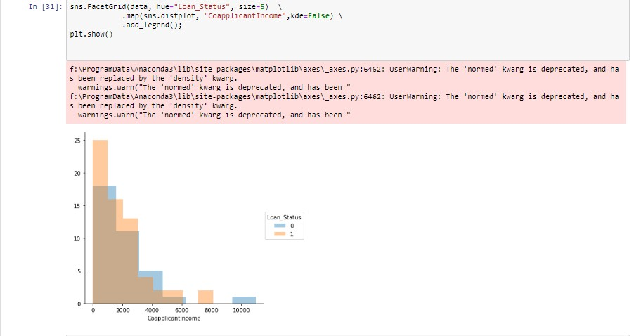
FACETGRID of COAPPLICANT INCOME on LOAN STATUS

Slide 26
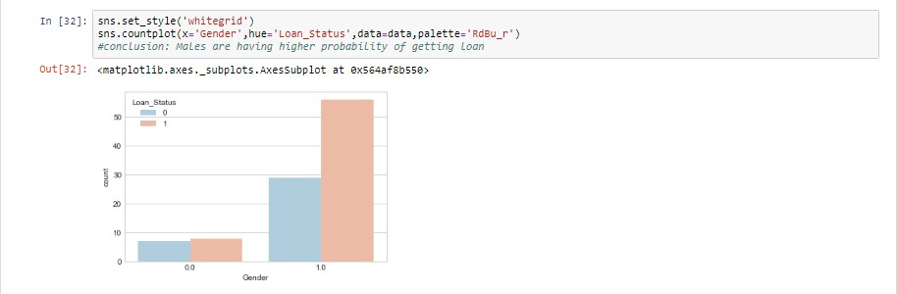
COUNTPLOT of GENDER on LOAN STATUS

Slide 27
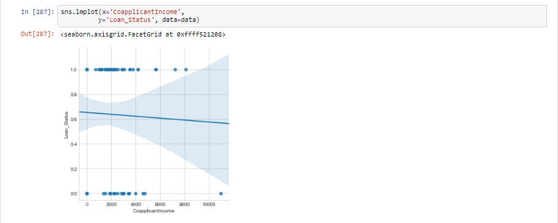
LMPLOT between COAPPLICANT INCOME and LOAN STATUS

Slide 28
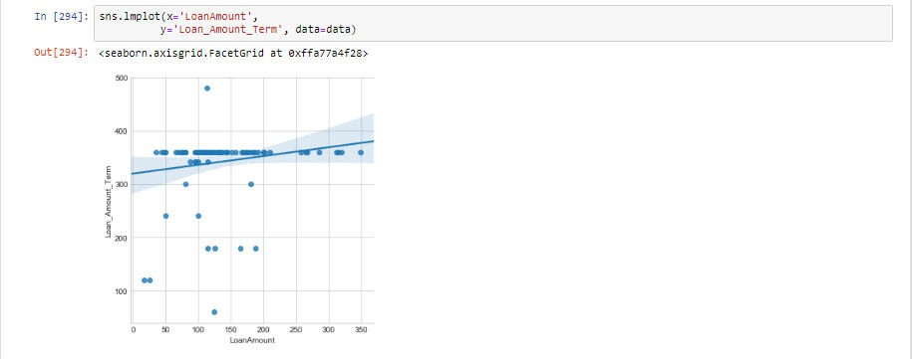
LMPLOT between LOAN AMOUNT and LOAN AMOUNT TERM

Slide 29
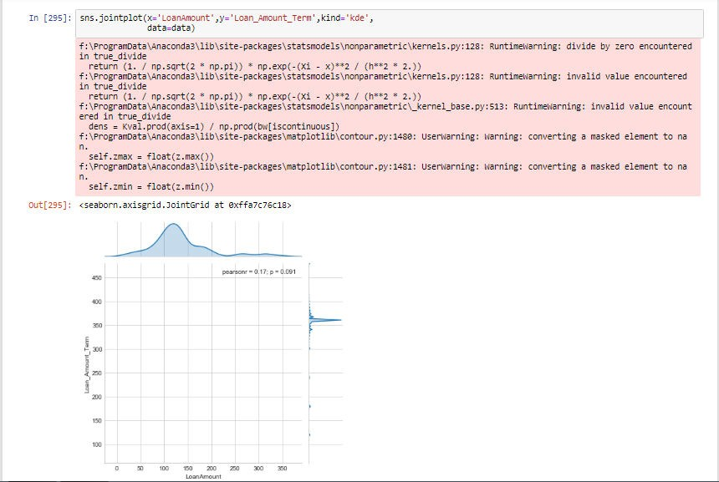
JOINTPLOT between LOAN AMOUNT and LOAN AMOUNT TERM

Slide 30
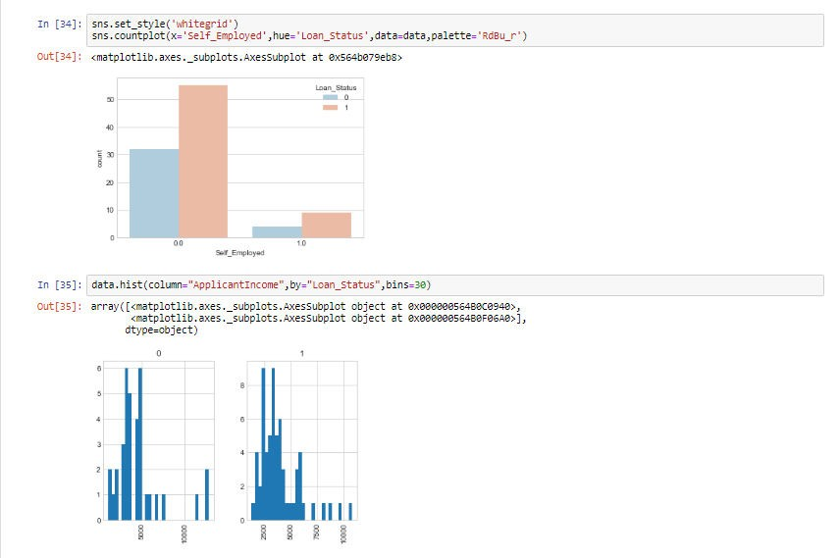
1.COUNTPLOT of SELF-EMPLOYED on LOAN STATUS;
2.HISTOGRAM between APPLICANT INCOME and LOAN-STATUS

Slide 31
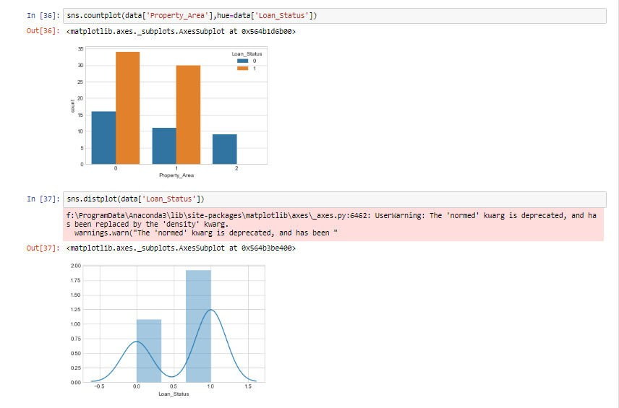
1.COUNTPLOT of PROPERTY AREA ON LOAN STATUS;
2.DISTPLOT on LOAN STATUS

Slide 32
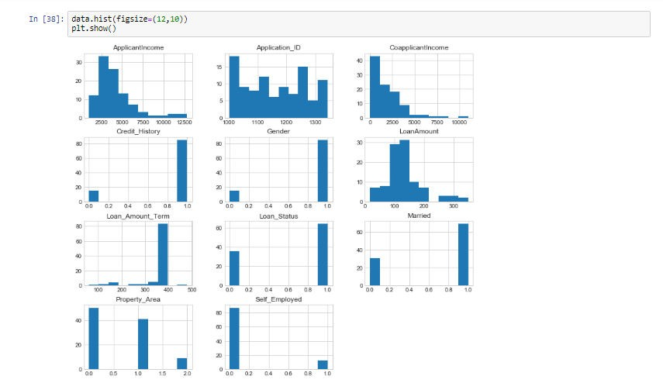
HISTOGRAMS OF DATA

Slide 33
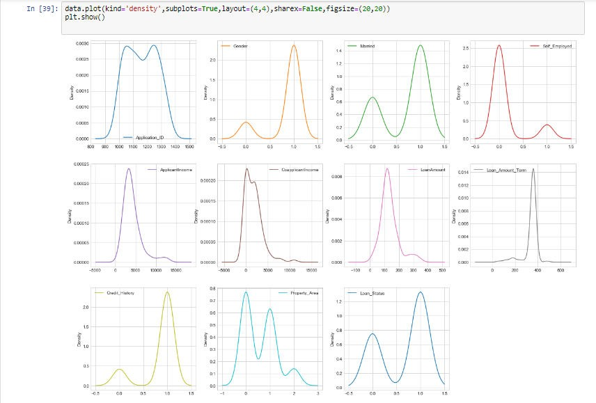

Slide 34
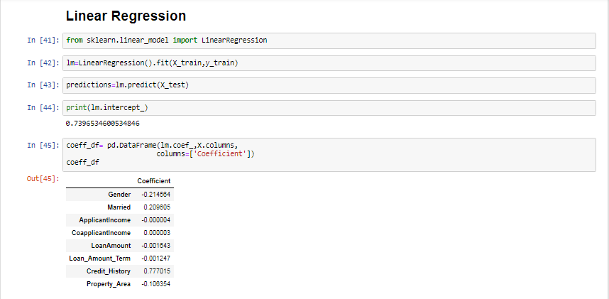

Slide 35
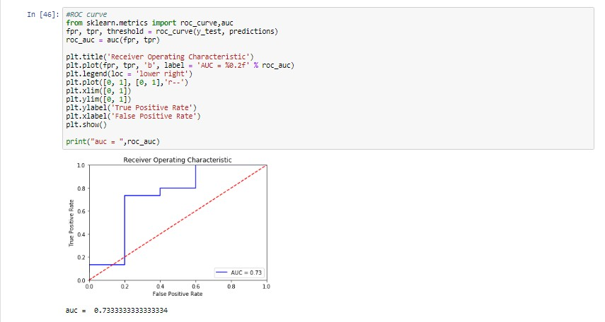

Slide 36
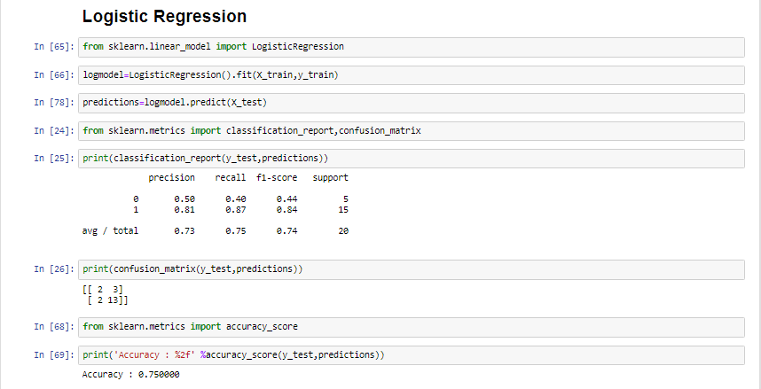

Slide 37
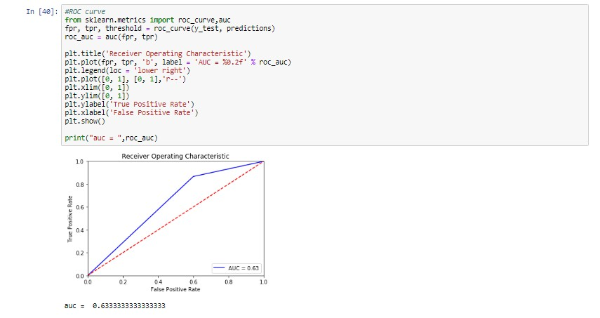

Slide 38
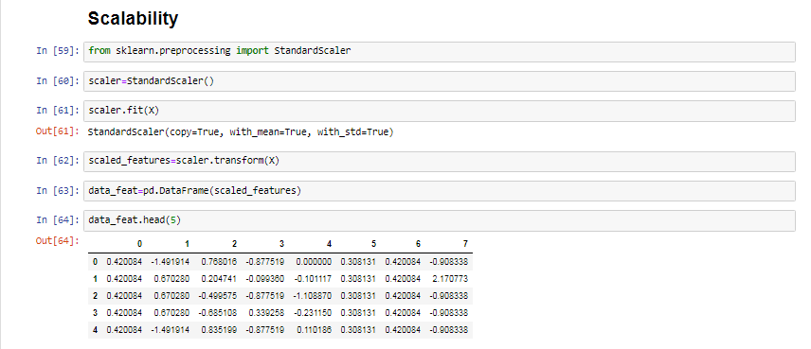

Slide 39
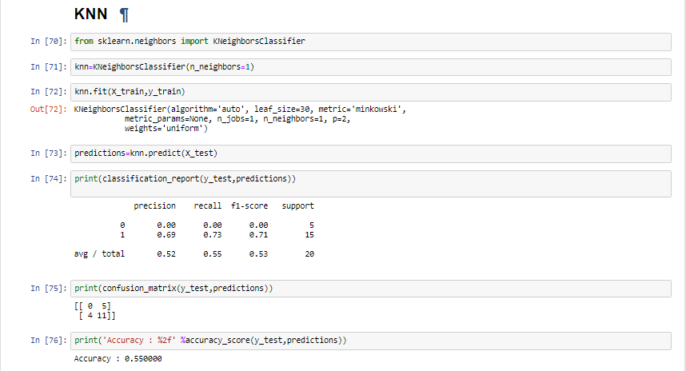

Slide 40
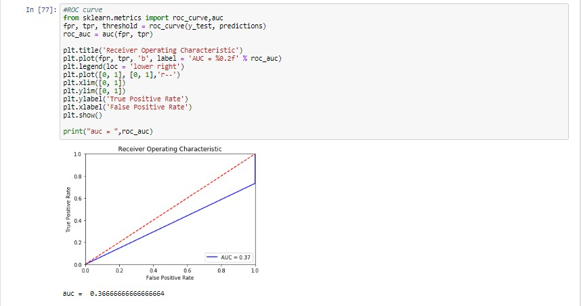

Slide 41
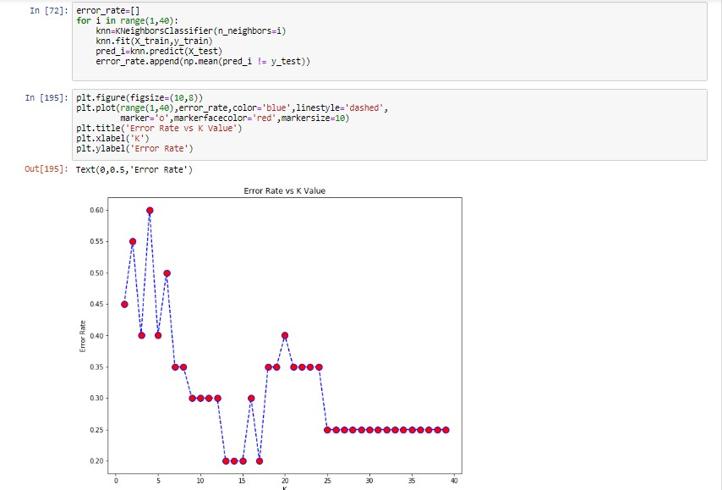

Slide 42
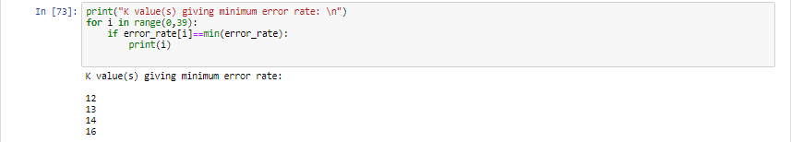

Slide 43
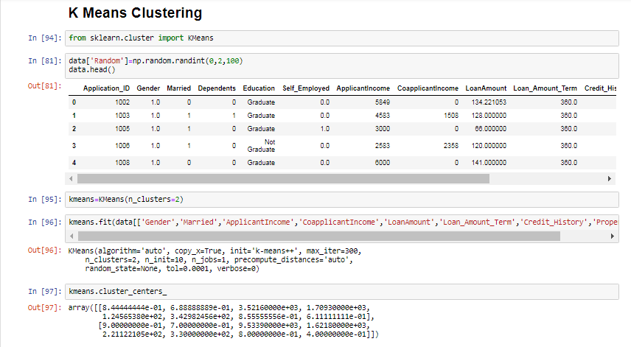

Slide 44
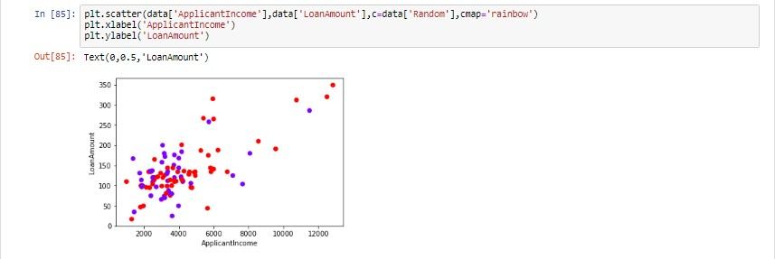

Slide 45
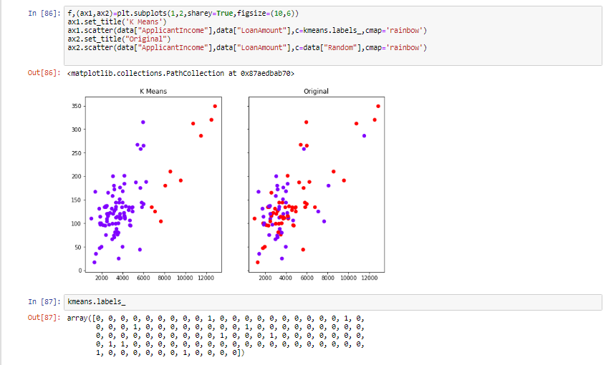

Slide 46
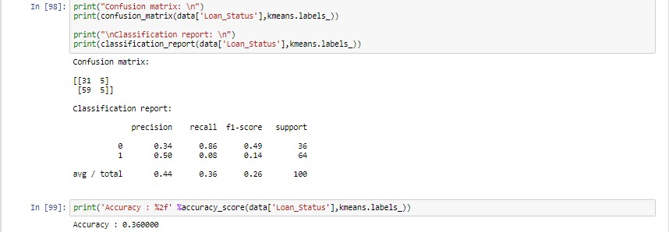

Slide 47
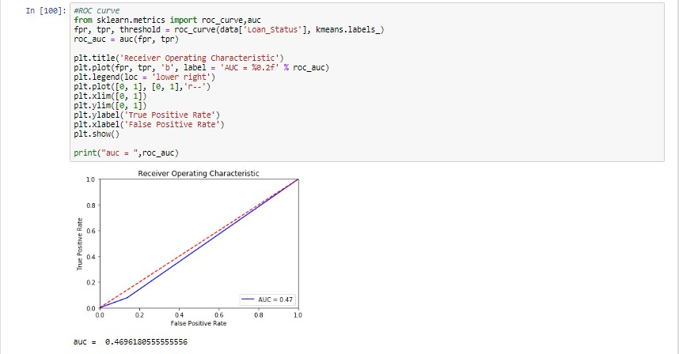

Slide 48
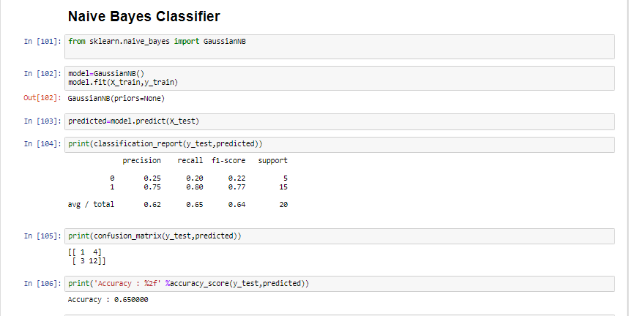

Slide 49
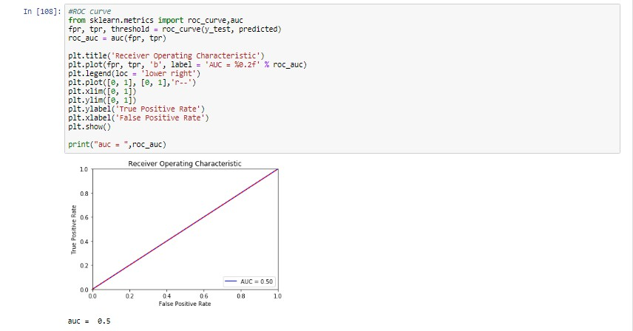

Slide 50
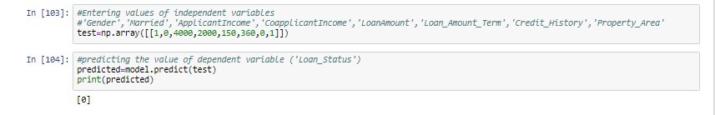

Slide 51
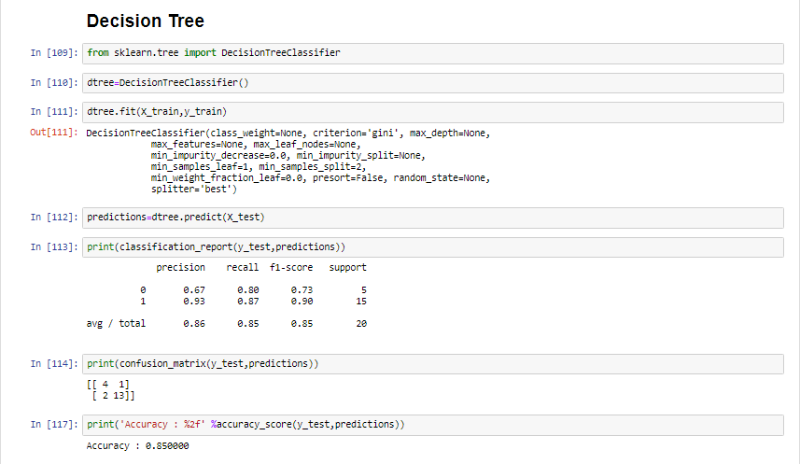

Slide 52
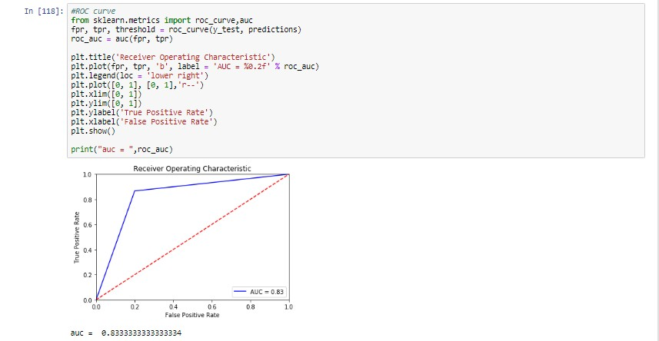

Slide 53
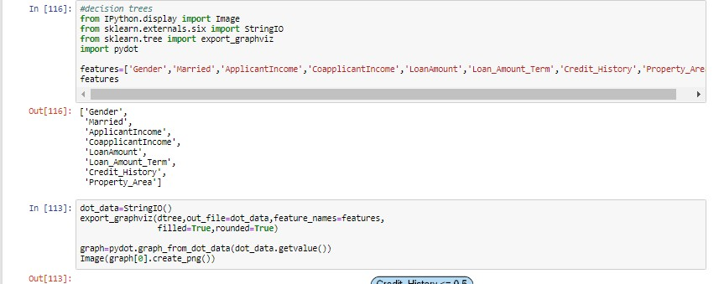

Slide 54
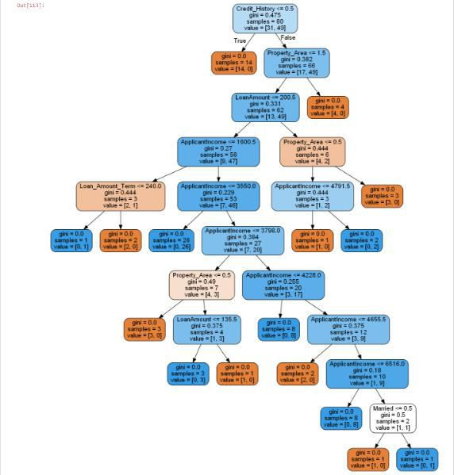

Slide 55
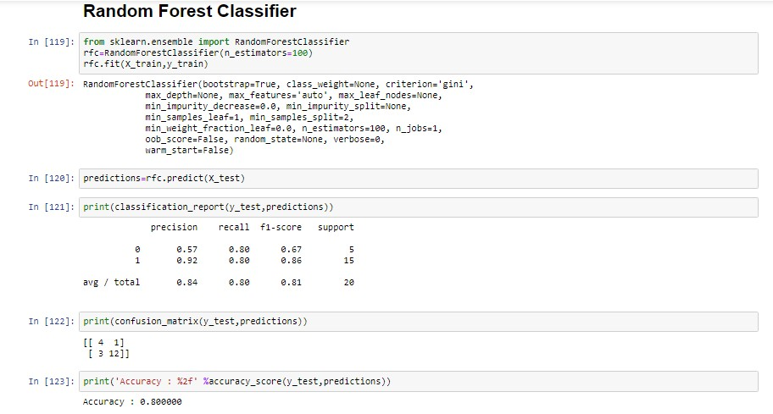

Slide 56
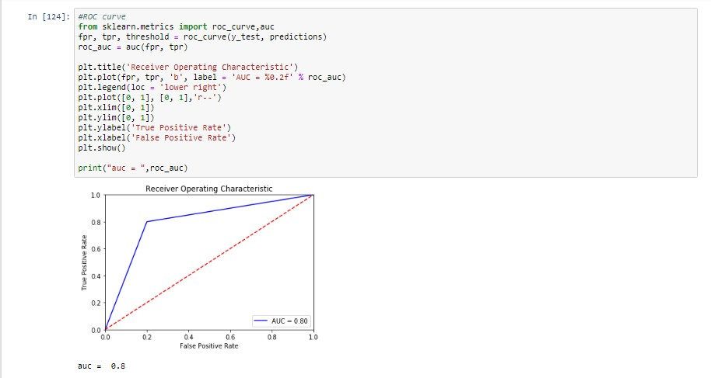

Slide 57
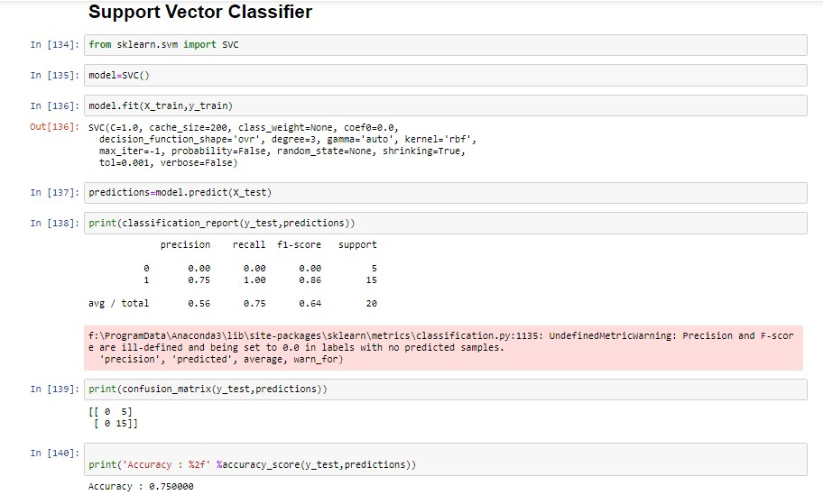

Slide 58
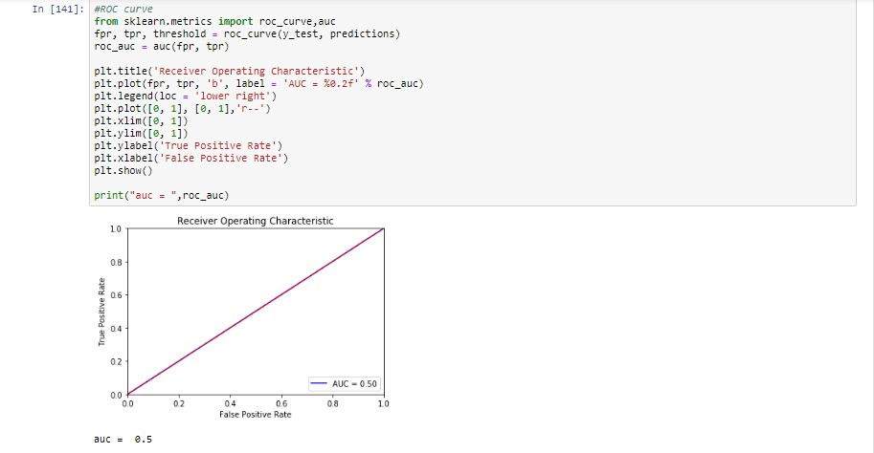

Slide 59
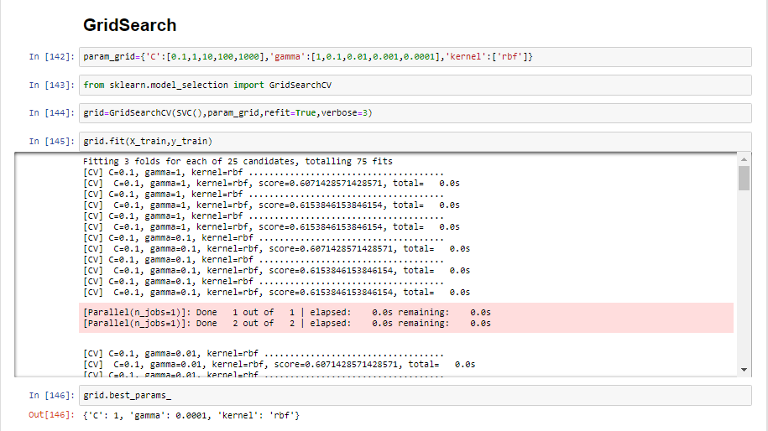

Slide 60
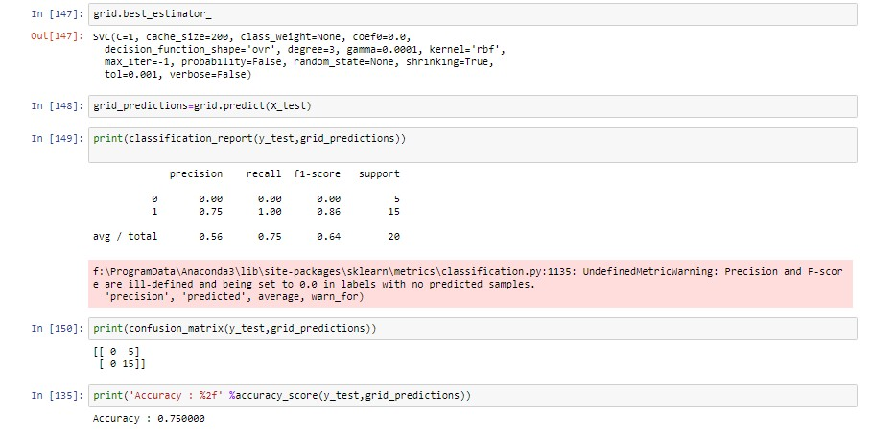

Slide 61
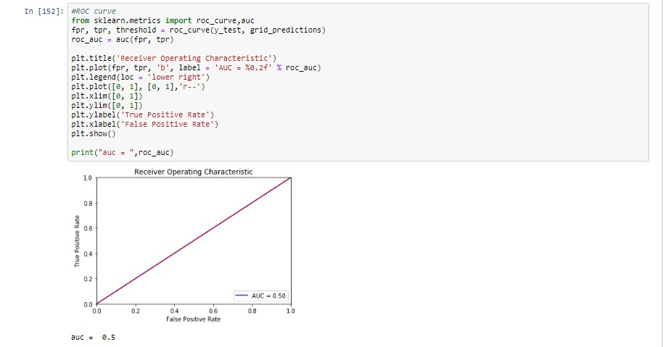

Slide 62
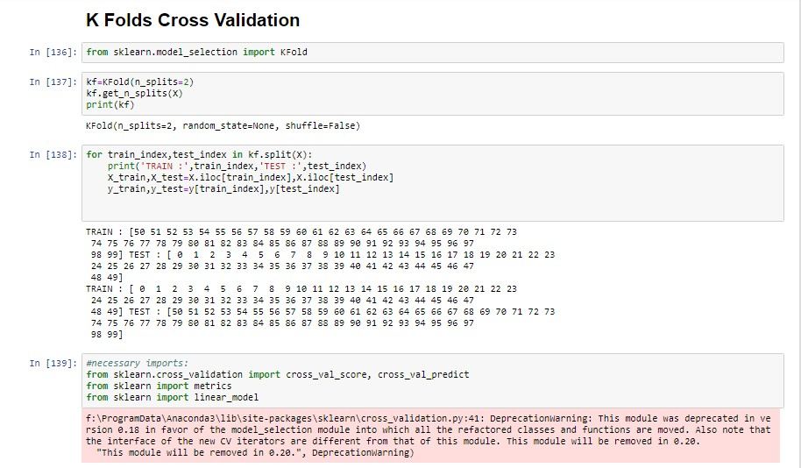

Slide 63


Slide 64


Slide 65


Slide 66


Slide 67
Future Scope of Improvements
In the near future the so –called software could be made more secure, reliable and dynamic .In near future this module of prediction can be integrated with the module of automated processing system. The system is trained on old training dataset. In future software can be made such that new testing date should also take part in training data after some fixed time.

Slide 68

Certificate
This is to certify that Mr. SAYAN DEY of GOVT. COLLEGE OF ENGG & CERAMIC TECHNOLOGY, registration number: 151130110024 of 2015-16, has successfully completed a project on PREDICT LOAN APPLICATION STATUS using MACHINE LEARNING WITH PYTHON under the guidance of Mr. ANUBHAV CHATURVEDI.
----------------------------------------
Mr. ANUBHAV CHATURVEDI
Globsyn Finishing School

Slide 69
Certificate
This is to certify that Mr. SURYA RUIDAS of GOVT. COLLEGE OF ENGG & CERAMIC TECHNOLOGY, registration number: 151130110037 of 2015-16, has successfully completed a project on PREDICT LOAN APPLICATION STATUS using MACHINE LEARNING WITH PYTHON under the guidance of Mr. ANUBHAV CHATURVEDI.
----------------------------------------
Mr. ANUBHAV CHATURVEDI
Globsyn Finishing School

Slide 70
Certificate
This is to certify that Mr. KUNTAL DAS of GOVT. COLLEGE OF ENGG & CERAMIC TECHNOLOGY, registration number: 151130110013 of 2015-16, has successfully completed a project on PREDICT LOAN APPLICATION STATUS using MACHINE LEARNING WITH PYTHON under the guidance of Mr. ANUBHAV CHATURVEDI.
----------------------------------------
Mr. ANUBHAV CHATURVEDI
Globsyn Finishing School

Slide 71
Certificate
This is to certify that Ms. SHREYA DAS of GOVT. COLLEGE OF ENGG & CERAMIC TECHNOLOGY, registration number: 151130110064 of 2015-16, has successfully completed a project on PREDICT LOAN APPLICATION STATUS using MACHINE LEARNING WITH PYTHON under the guidance of Mr. ANUBHAV CHATURVEDI.
----------------------------------------
Mr. ANUBHAV CHATURVEDI
Globsyn Finishing School

Slide 72

…

